Slide 1

Rapid Optimization Library
SAND2014-19572 C
Drew Kouri, Denis Ridzal
Bart van Bloemen Waanders, Greg von Winckel
Sandia National Laboratories
Optimization & UQ, Org. 1441
Apr-30-2015

Slide 2
What is ROL?
Motivation
Problem formulations
Application programming interface
Methods
Research focus

Slide 3
Rapid Optimization Library (ROL)
ROL is a Trilinos package for large-scale continuous optimization, a.k.a. nonlinear programming (NLP).
Available in Trilinos since 10/21/2014.
ROL includes:
  A rewrite and consolidation of existing optimization tools in Trilinos: Aristos, MOOCHO, Optipack, Globipack.
  Hardened, production-ready algorithms for unconstrained and equality-constrained continuous optimization.
  Methods for efficient handling of inequality constraints.
  A unified interface for simulation-based optimization.
  New methods for efficient handling of inexact computations.
  New methods for optimization under uncertainty.

Slide 4
Motivation
Optimization of differentiable simulated processes:
  partial differential equations (PDEs)
  differential algebraic equations (DAEs)
  network equations (gas pipelines, electrical networks)
Inverse problems, model calibration.
Optimal design, including topology and shape optimization.
Optimal control, optimal design of experiments, etc.
Parameter/design/control spaces can be very large, often related to the size of the computational mesh (PDEs) or the size of the device network or graph (DAEs).
Simulated processes may be subject to uncertainty.

Slide 5
Motivation
Example cost of deterministic optimization, in terms of “simulation units”, such as nonlinear PDE/DAE solves:
We want derivative-based methods.
We want embedded and matrix-free methods:
  Direct access to application data structures: vectors, etc.
  Direct use of application methods: (non)linear solvers, etc.
Information | Size of parameter space |  |  |  | Methods
 | 1 | 10 | 10³ | 10⁶
Function samples (incl. finite diff’s) | 100 | 10,000 | ∞ | ∞ | Global search or steepest descent
Analytic gradients (hand-coded or AD) | 50 | 100 | 200 | 1,000 | Quasi-Newton
Analytic Hessians (hand-coded or AD) | 50 | 50 | 50 | 50 | Newton-Krylov

Slide 6
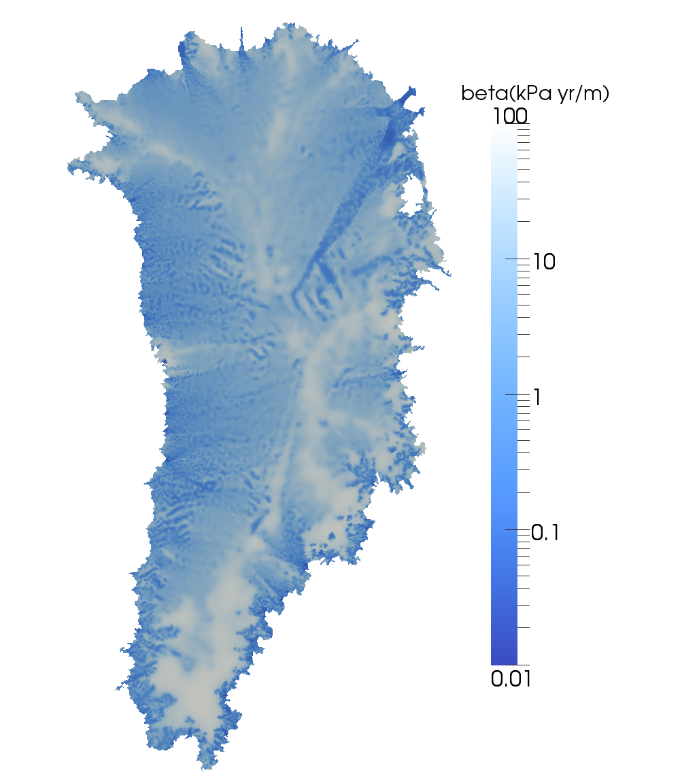
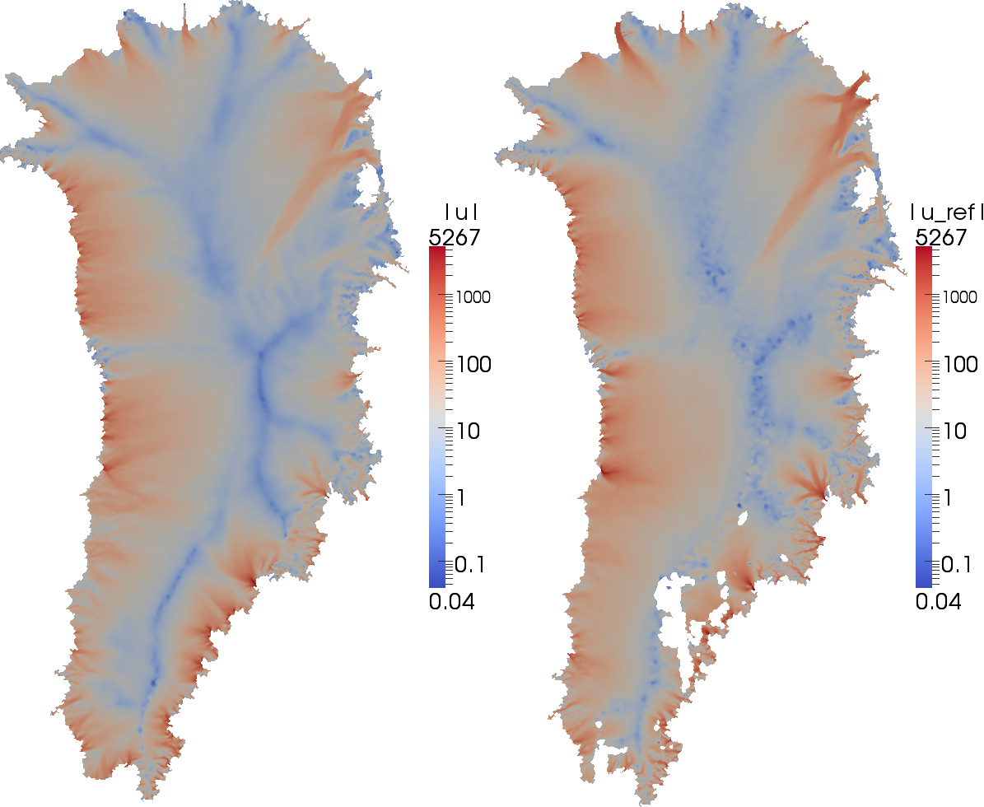
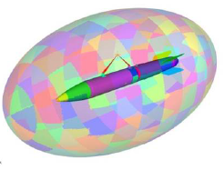
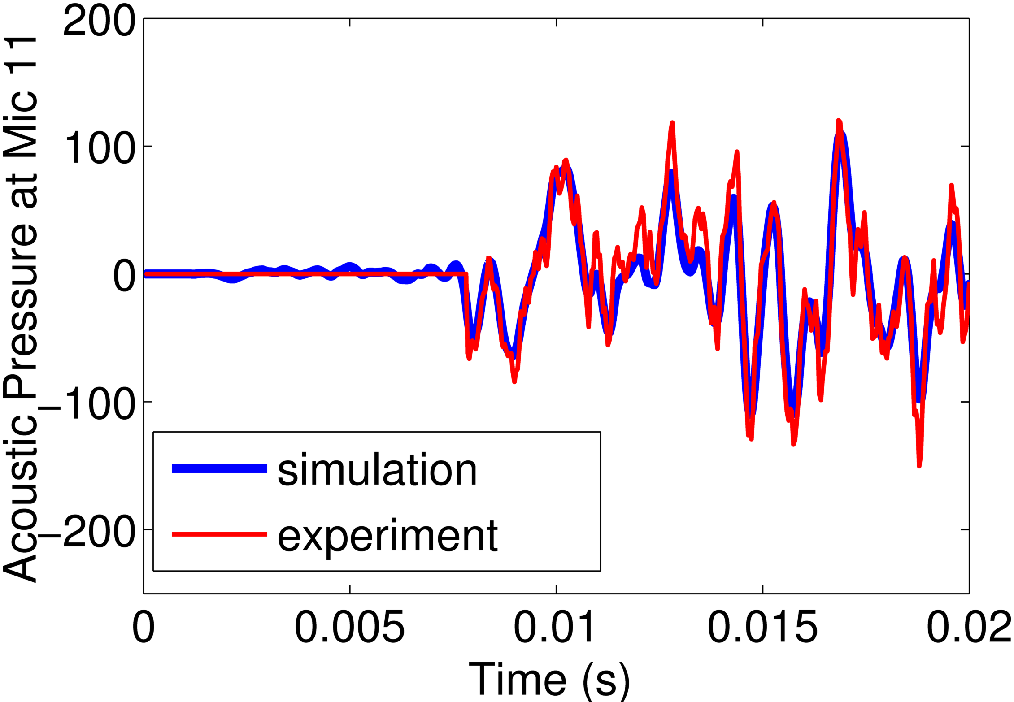
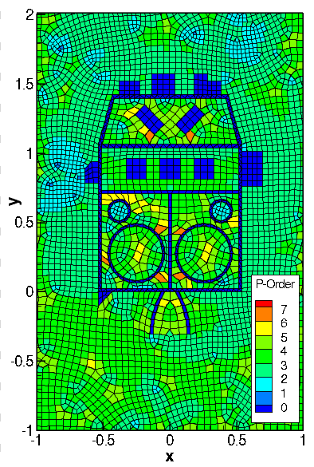
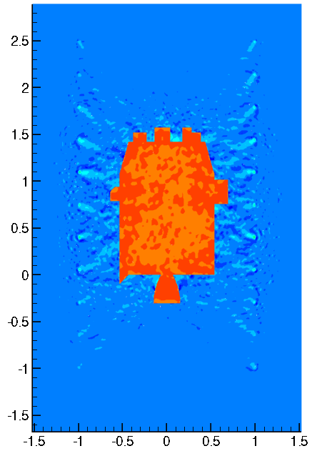
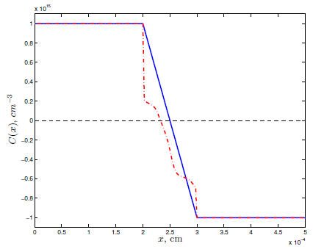
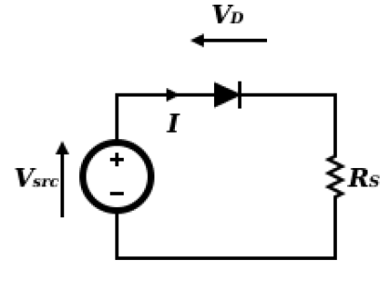
A few current use cases
Inverse problems in acoustics / elasticity.
Interface to the Sierra-SD structural dynamics code (Sandia, Org. 1500).
Interface to DGM, a high-order DG code (Sandia, Org. 1400).
Estimating basal friction of ice sheets.
Interface to LifeV Project (www.lifev.org).
65K distributed optimization variables
700,000
state variables
1M optimization variables, 1M state variables
Calibration of electrical device models.
Prototype using Xyce circuit simulator.
175K distributed optimization variables
525K x 10K
state variables
50 optimization variables (in-memory or disk storage)
Others

Slide 7
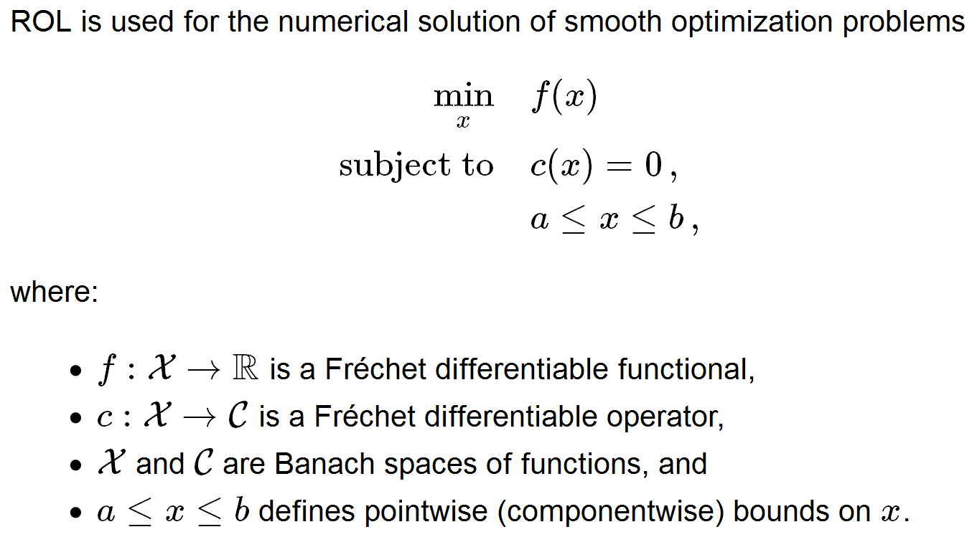
Mathematical abstraction
Straight from ROL’s documentation:
This abstraction is a valuable guiding principle.

Slide 8
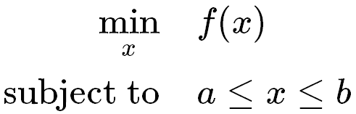

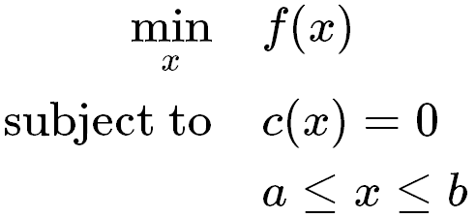
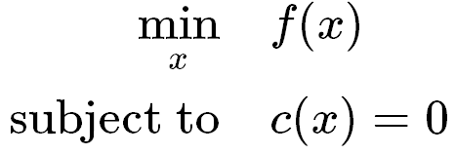
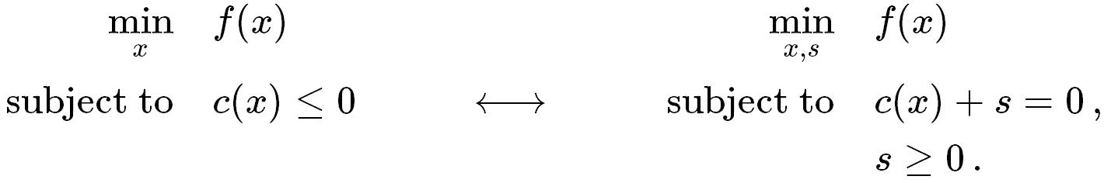
Problem formulations
ROL supports four basic NLP problem types:
Type-U: Unconstrained.
Type-B: Bound constrained.
Type-E: Equality constrained.
Type-EB: Equalities + bounds.
Note:

Slide 9
Design of ROL
Application programming interface
Linear algebra interface
Vector
Functional interface
Objective
BoundConstraint
EqualityConstraint
Algorithmic interface
StatusTest
Step
DefaultAlgorithm
SimOpt Middleware
Methods – Implementations of Step instances

Slide 10
Linear algebra interface
ROL::Vector is designed to enable direct use of application data structures (serial, parallel, in-memory, disk-based, etc.).
Methods:
plus, scale, dot, norm, clone (pure virtual)
axpy, zero, set (virtual)
basis, dimension (optional)
Nothing new. History: HCL/RVL, TSFCore, Thyra.
Recent applications of ROL require dual-space operations:
dual (virtual)
Note: Other Trilinos packages have similar linear algebra interfaces, but may not be able to take advantage of dual-space operations, such as Riesz maps.

Slide 11
Functional interface
ROL::Objective provides the objective function interface.
Methods:
value (pure virtual)
gradient, hessVec (virtual)
update, invHessVec, precond, dirDeriv (optional)
We can use finite differences to approximate missing derivative information (default implementation).
For best performance, implement analytic derivatives.
Tools: checkGradient, checkHessVec, checkHessSym.
ROL::BoundConstraint enables pointwise bounds on optimization variables, in support of projected gradient, projected Newton, and primal-dual active set methods.

Slide 12
Functional interface
ROL::EqualityConstraint enables equality constraints.
Methods:
value (pure virtual)
applyJacobian, applyAdjointJacobian, (virtual)
applyAdjointHessian
update, applyPreconditioner, (optional)
solveAugmentedSystem
We can use finite differences to approximate missing derivative information (default implementation).
For best performance, implement analytic derivatives.
Tools: checkApplyJacobian, etc.

Slide 13
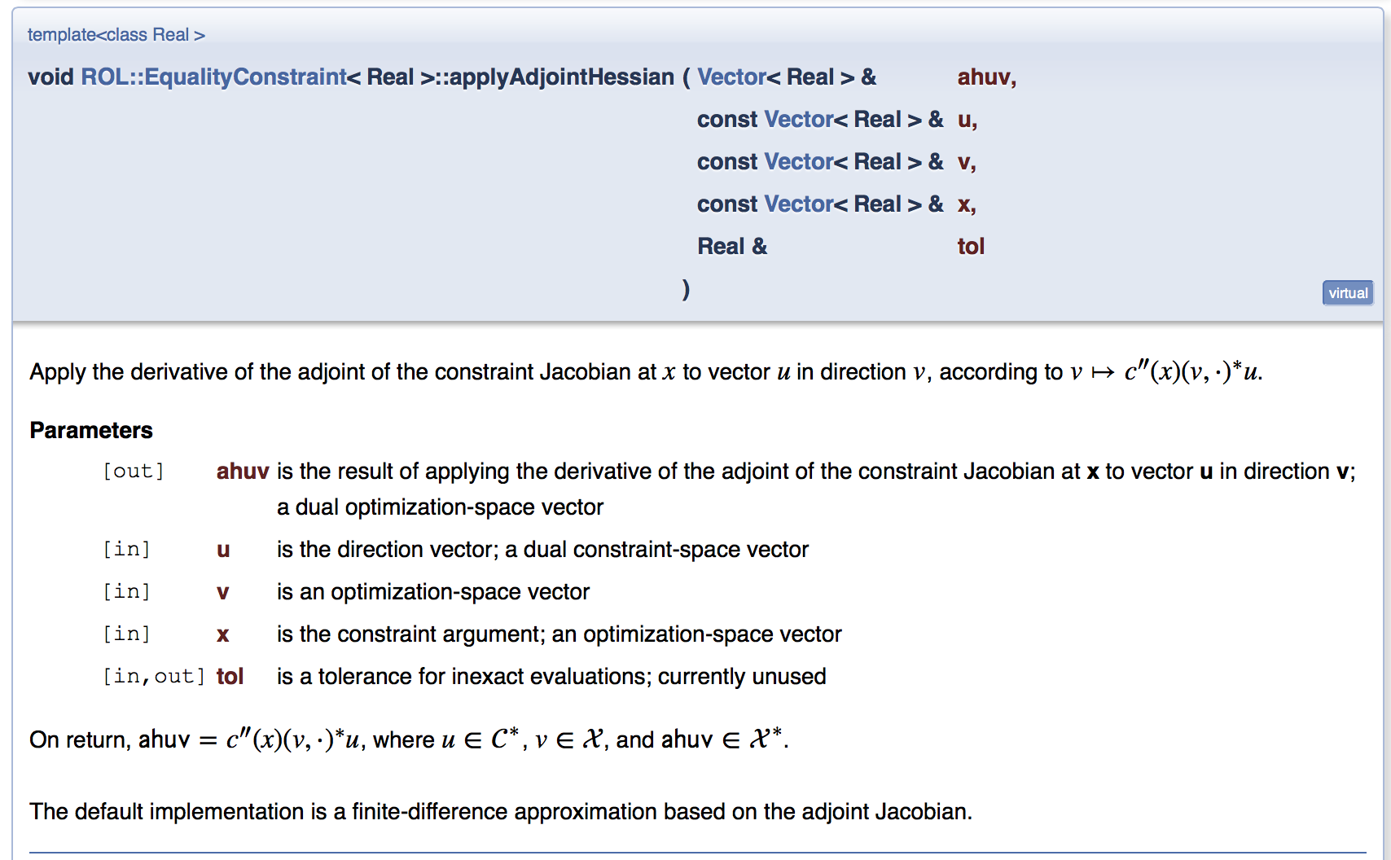
Functional interface
Documentation excerpt:

Slide 14
SimOpt: The middleware for engineering optimization
Many simulation-based Type-E problems have the form:
  u denote simulation variables (state variables, basic, Sim)
  z denote optimization variables (controls, parameters, nonbasic, Opt)
A common Type-U reformulation, by nonlinear elimination, is:
For these cases, the SimOpt interface enables direct use of methods for both unconstrained and constrained problems.

Slide 15
SimOpt: The middleware for engineering optimization
Objective_SimOpt
value(u,z)
gradient_1(g,u,z)
gradient_2(g,u,z)
hessVec_11(hv,v,u,z)
hessVec_12(hv,v,u,z)
hessVec_21(hv,v,u,z)
hessVec_22(hv,v,u,z)
Note: 1 = Sim = u
2 = Opt = z
EqualityConstraint_SimOpt
value(c,u,z)
applyJacobian_1(jv,v,u,z)
applyJacobian_2(jv,v,u,z)
applyInverseJacobian_1(ijv,v,u,z)
applyAdjointJacobian_1(ajv,v,u,z)
applyAdjointJacobian_2(ajv,v,u,z)
applyInverseAdjointJacobian_1(iajv,v,u,z)
applyAdjointHessian_11(ahwv,w,v,u,z)
applyAdjointHessian_12(ahwv,w,v,u,z)
applyAdjointHessian_21(ahwv,w,v,u,z)
applyAdjointHessian_22(ahwv,w,v,u,z)
solve(u,z)

Slide 16
SimOpt: Benefits
Streamlined modular implementation for a very large class of engineering optimization problems.
Implementation verification through a variety of ROL tests:
  Finite difference checks with high granularity.
  Consistency checks for operator inverses and adjoints.
Access to all optimization methods through a single interface.
Enables future ROL interfaces for advanced solution checkpointing and restarting, closer integration with application-specific time integrators, etc.

Slide 17
Algorithmic interface
Modular design:
gtol,stol,maxit
ROL::Vector
ParameterList
ROL::StatusTest
ROL::Step
ROL::Objective
ROL::E/B/Constraint
ROL::Algorithm
run

Slide 18
Algorithmic interface
An illustration, sans details, using a sequential quadratic programming (SQP) step for Type-E formulations:
RCP<Objective<RealT> > obj;
RCP<EqualityConstraint<RealT> > constr;
RCP<CompositeStepSQP<RealT> > step(parlist);
RCP<StatusTestSQP<RealT> > status(gtol, ctol, stol, maxit);
DefaultAlgorithm<RealT> algo(step, status);
x.zero(); vl.zero();
algo.run(x, vl, *obj, *constr);

Slide 19
Methods – Part 1
Type-U (unconstrained):
  Globalization: LineSearchStep and TrustRegionStep.
  Gradient descent, quasi-Newton (limited-memory BFGS, DFP, Barzilai-Borwein), nonlinear CG (6 variants), inexact Newton (including finite difference hessVecs), Newton, with line searches and trust regions.
  Trust-region methods supporting inexact objective functions and inexact gradient evaluations. Enables adaptive and reduced models.
Type-B (bound constrained):
  Projected gradient and projected Newton methods.
  Primal-dual active set methods.

Slide 20
Methods – Part 2
Type-E (equality constrained):
  Sequential quadratic programming (SQP) with trust regions, supporting inexact linear system solves.
  A hierarchy of full-space SQP methods, based on the constraint null-space representation (summer 2015):
  (1) sim/opt splitting with simple linearized forward and adjoint solves, (2) simple optimality systems with forward/adjoint preconditioners,
  (3) full KKT (optimality) system solves.
Type-EB (equality + bound constrained):
  Augmented Lagrangian methods.
  Semismooth Newton methods (summer 2015).
  Interior-point methods (summer 2015).

Slide 21
Methods – Part 3
Optimization under uncertainty:
  Compute controls/designs that are risk-averse or robust to uncertainty in the parameters ϑ. Here σ is some risk measure.
  Risk measures: Conditional value-at-risk (CVaR), Expectation (mean), Mean plus deviation, Mean plus variance, Exponential disutility.
  Incorporate sampling and adaptive quadrature approaches from uncertainty quantification. Flexible sampling interface through SampleGenerator and BatchManager.
  Control inexactness and adaptivity through trust-region framework.

Slide 22
Research focus
Optimization under uncertainty, risk-averse optimization.
Treatment of general constraints in large-scale optimization.
Sequential subspace methods, continuation, regularization.
Inexact and adaptive methods for large-scale optimization.
Tighter application integration through SimOpt.

Slide 23
Miscellaneous
Efficient computations, restarts and checkpointing enabled through AlgorithmState and StepState.
Flexible output using user-defined streams.
Soft and hard iteration updates are possible, for efficiency.
Coming in 2015:
  Specialized techniques for topology optimization, such as generalizations of method of moving asymptotes (MMA).
  Computing conservative estimates of probability of failure,
  through buffered probabilities.
  Methods for general constraints.
  Hierarchy of full-space SQP methods.
  User’s guide.

Slide 24


Slide 25
Supplementary material

Slide 26
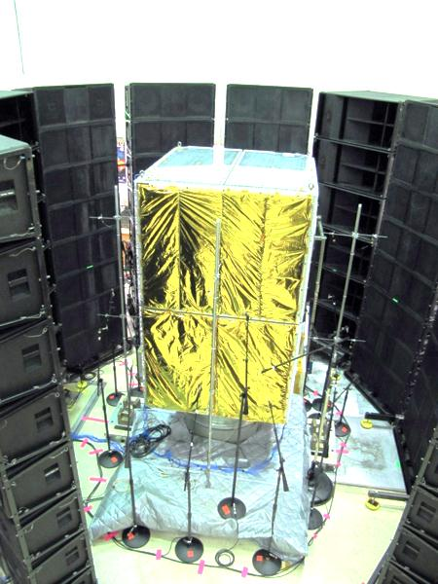
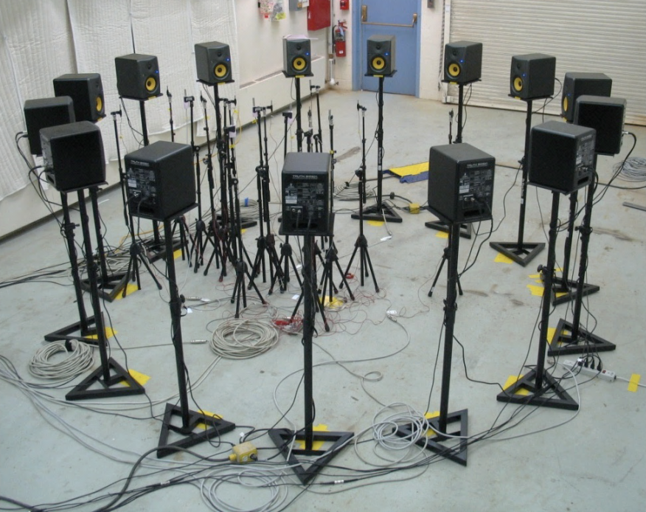
Another important application:
Direct-field acoustic testing (DFAT)
The purpose of DFAT in the weapon program is to simulate in the lab
liftoff/in-flight/reentry environments (W78) and vibrational conditions (B61)
enabling: (1) reduction in cost of testing & (2) predictive component analysis.
Source: www.msi-dfat.com
Full-system testing facility
Mobile facility
Computational simulation must aid lab experiments:
model calibration, material/source inversion, loudspeaker control
→ OPTIMAL DESIGN AND INVERSE PROBLEMS

Slide 27
Optimal design
Given:
- a set of loudspeakers;
- a waveform generator;
- a mixer board;
can we create a specified acoustic pressure field in a region of interest?

Slide 28
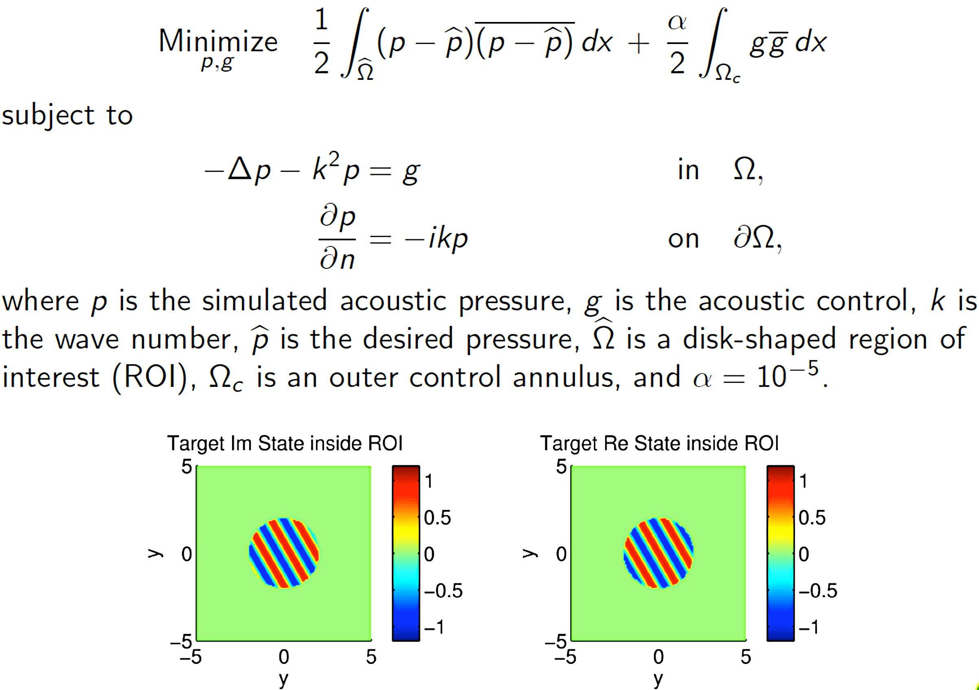
Optimal design

Slide 29
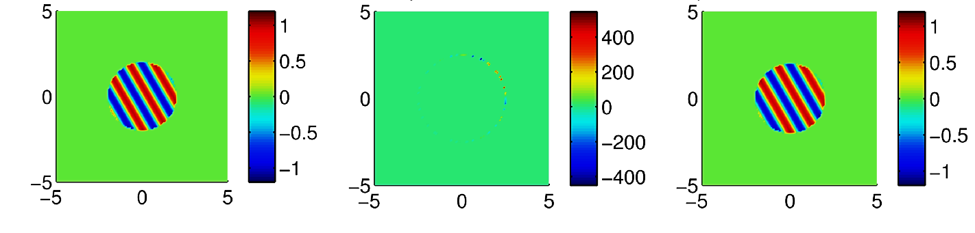
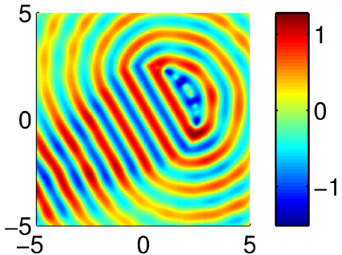
Optimal design
Desired Pressure Speaker Design Realized Pressure

Slide 30
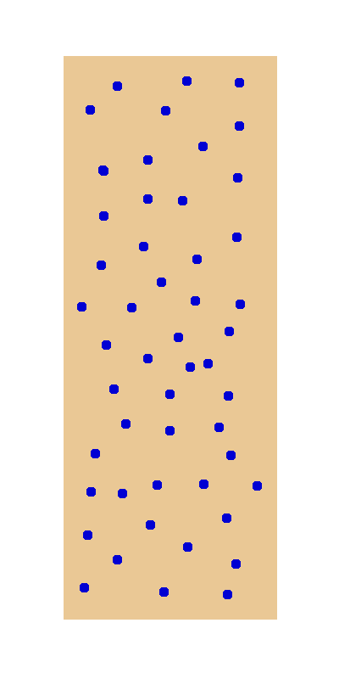
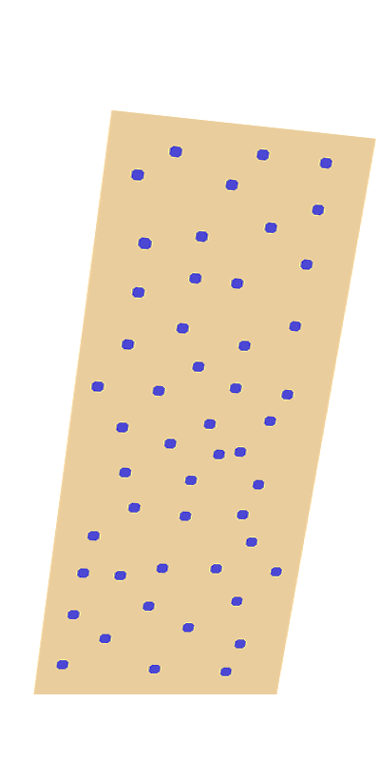
Inversion
Foam block at rest
Deformed foam block

Slide 31
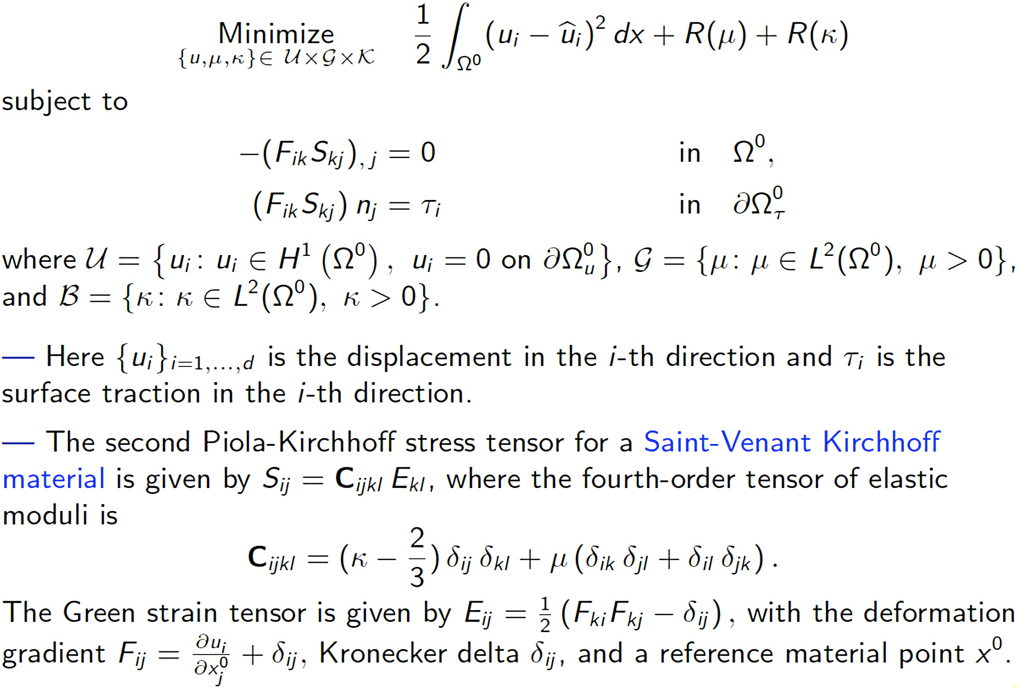
Inversion

